Slide 1

Using Empathy to Make Tests Easy and Code Safe
Marian Hartman, PhD
@DigDeepRoots

Slide 2


Slide 3


Business Problem
Being productive requires making code changes.
Any change adds risk.

Slide 4
I can’t change it without tests
I can’t test it without changing it

Slide 5

ONLY purpose:
Document can’t be changed.

Slide 6


Slide 7


Slide 8

Illusion of Control

Slide 9
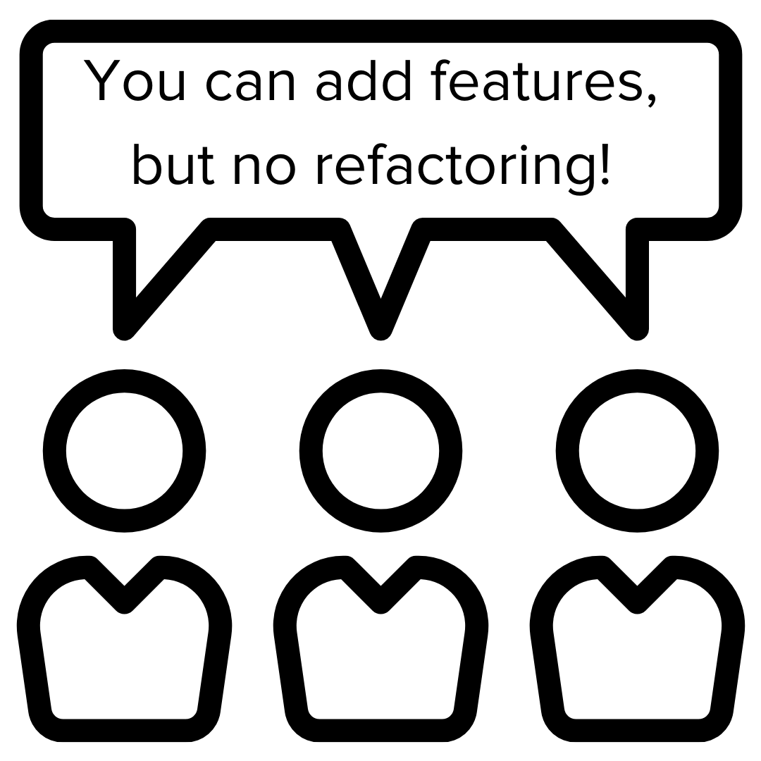

Slide 10
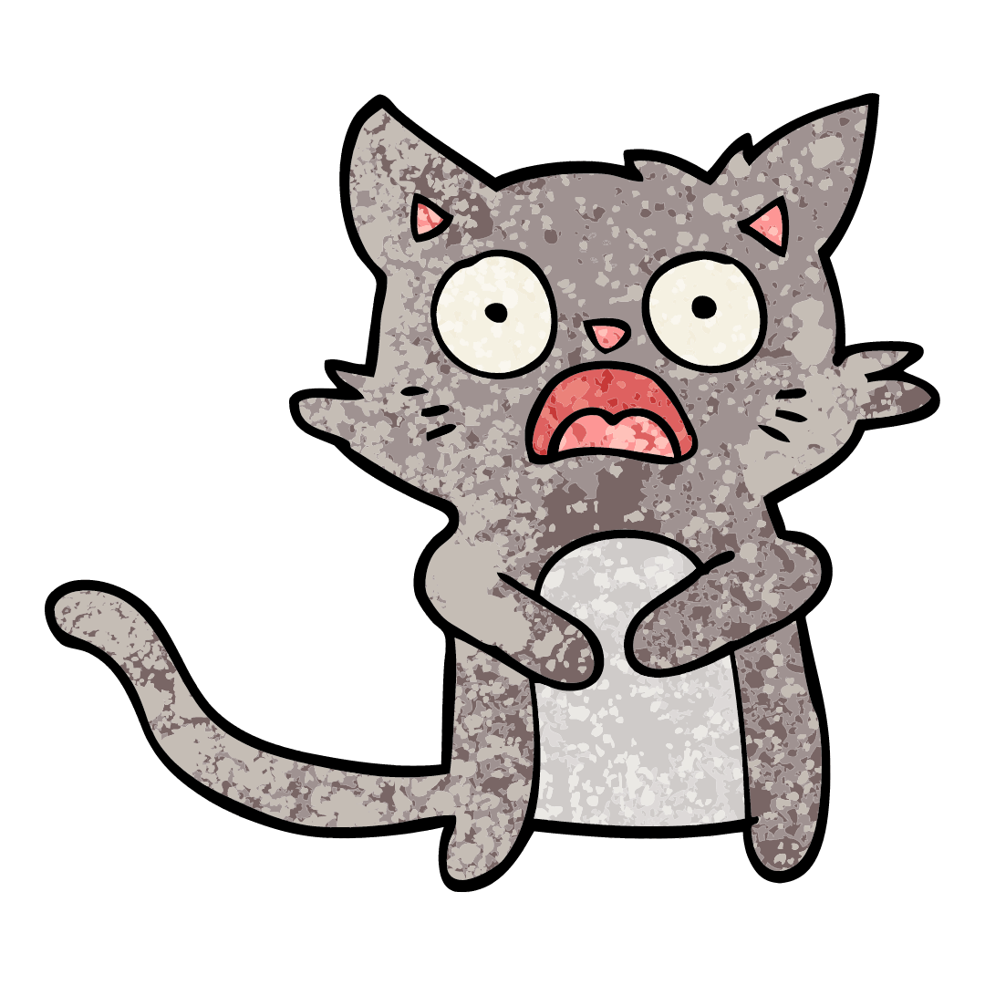


Slide 11




Slide 12




Slide 13
Global Term: “Licences”
EU Context:
“Licence” adds responsibility
Solution:
Change to “Access Grants”

Slide 14


Exposure’s Known Risk
The Fix!
Maybe….
Unknown Risk

Slide 15
Existing Solutions
Refactoring
Automated Tests
Tools
System Empathy

Slide 16
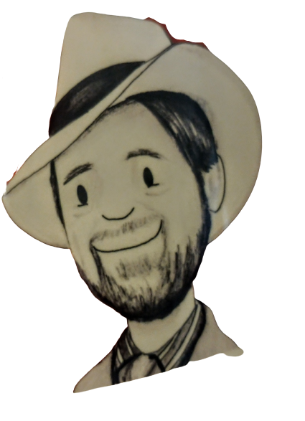
@ArloBelshee

Slide 17
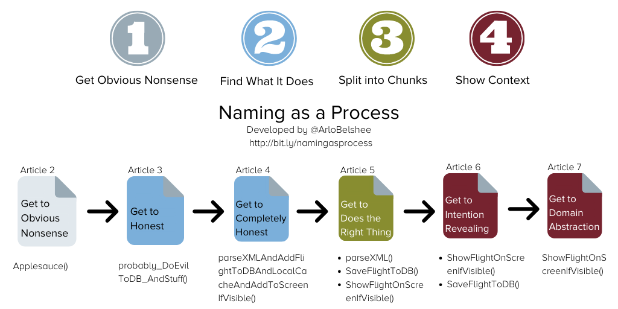

Slide 18
The Contract
We all want to work together with clients to help them learn the X set of skills.
The customer has too many employees for us to teach them all at once, so we will break them into groups. Similarly, the curriculum breaks the total set of knowledge and skills into several chunks that can be learned separately. When we interact with a customer, we will help them develop a strategy for dividing their employees into learning groups and providing separate pieces of the content and all related instruction and support for that content to each group. We agree to share all money equally between the partners involved in the interaction. We will define the overall strategy for spreading the skills across the client based on the customer’s measures of success, which the person signing the contract will determine with the company and then tell to everyone else involved. The skills and ways of learning them are valuable IP, and the curriculum is owned by the people that created it. No one else can teach these skills except as specified in this agreement. The person doing the measuring will also make sure that we record those measures and report them to the right stakeholders, though the person signing the contract will manage the relationship and ensure stakeholders are happy and that the roadmap is followed. Each time we help a single set of employees learn a particular set of skills, we will be able to assess that those skills have been learned, that they are being applied on real work, and the business impacts of that application (in terms of the measures agreed to for the total interaction between the customer and the person who signed the contract), and it is the responsibility of the person who created the curriculum to define the assessment, and the person who teaches it to run the assessment and share the data.
Too much unknown
So much reading time to understand intent
Misunderstanding intent
Changing one thing but not seeing another thing
Changing more than you intended

Slide 19
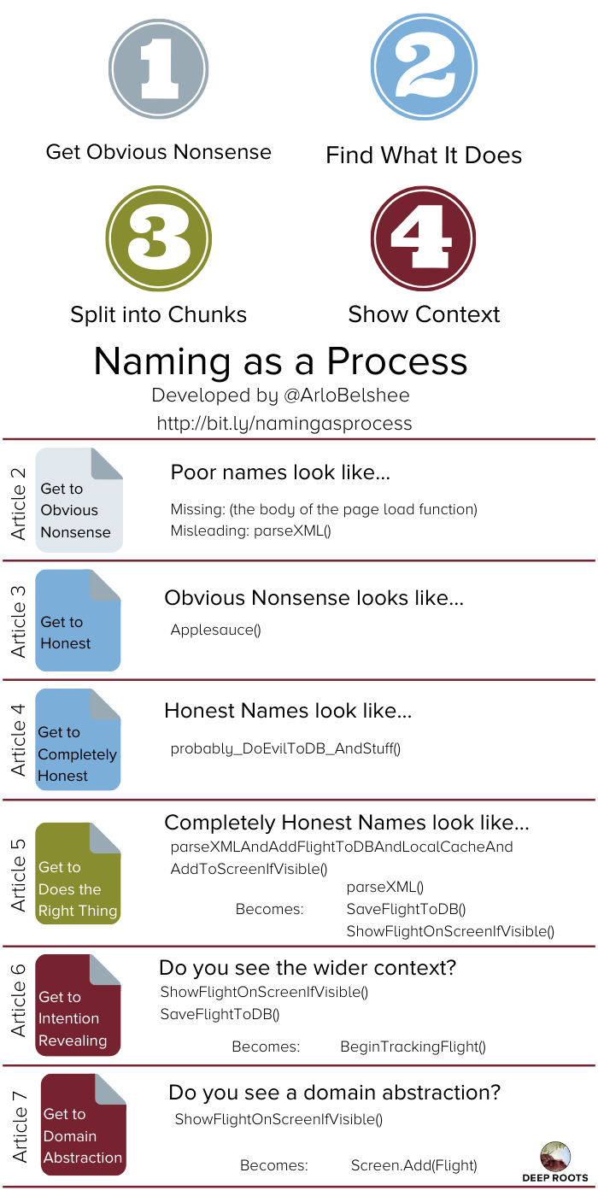
Missing Names
Consultant hereby irrevocably transfers and assigns to Company any and all of its right, title, and interest in and to all designs, discoveries, inventions, products, computer programs, procedures, business plans, revenue models, customer lists, marketing approaches or any similar business information, improvements, developments, drawings, notes, documents, information and materials made, conceived or developed by Consultant alone or with others which result from, relate to, or are used while providing the Services, including, but not limited to, any copyrights, patent rights, trade secrets and trademarks. all designs, discoveries, inventions, products, computer programs, procedures, business plans, revenue models, customer lists, marketing approaches or any similar business information, improvements, developments, drawings, notes, documents, information and materials made, conceived or developed by Consultant alone or with others which result from, relate to, or are used while providing the Services will be the sole and exclusive property of Company, and Company shall have the sole right to determine the treatment of any all designs, discoveries, inventions, products, computer programs, procedures, business plans, revenue models, customer lists, marketing approaches or any similar business information, improvements, developments, drawings, notes, documents, information and materials made, conceived or developed by Consultant alone or with others which result from, relate to, or are used while providing the Services, including the right to keep them as trade secrets, to file and execute patent applications on them, to use and disclose them without prior patent application, to file registrations for copyright or trademark on them in its own name, or to follow any other procedure that Company deems appropriate.
Consultant agrees: (a) to disclose promptly in writing to Company all all designs, discoveries, inventions, products, computer programs, procedures, business plans, revenue models, customer lists, marketing approaches or any similar business information, improvements, developments, drawings, notes, documents, information and materials made, conceived or developed by Consultant alone or with others which result from or relate to the Services; (b) to cooperate with and assist Company to apply for, and to execute any applications and/or assignments reasonably necessary to obtain, any patent, copyright, trademark or other statutory protection for all designs, discoveries, inventions, products, computer programs, procedures, business plans, revenue models, customer lists, marketing approaches or any similar business information, improvements, developments, drawings, notes, documents, information and materials made, conceived or developed by Consultant alone or with others which result from or relate to the Services in Company' name as Company deems appropriate; and (c) to otherwise treat all all designs, discoveries, inventions, products, computer programs, procedures, business plans, revenue models, customer lists, marketing approaches or any similar business information, improvements, developments, drawings, notes, documents, information and materials made, conceived or developed by Consultant alone or with others which result from or relate to the Services as Confidential Information, as defined below. These obligations to disclose, assist and assign the termination of this Agreement.

Slide 20
Identifying Obvious Nonsense – Extract Definition
Before
After
Consultant hereby irrevocably transfers and assigns to Company any and all of its right, title, and interest in and to all designs, discoveries, inventions, products, computer programs, procedures, business plans, revenue models, customer lists, marketing approaches or any similar business information, improvements, developments, drawings, notes, documents, information and materials made, conceived or developed by Consultant alone or with others which result from, relate to, or are used while providing the Services, including, but not limited to, any copyrights, patent rights, trade secrets and trademarks. All designs, discoveries, inventions, products, computer programs, procedures, business plans, revenue models, customer lists, marketing approaches or any similar business information, improvements, developments, drawings, notes, documents, information and materials made, conceived or developed by Consultant alone or with others which result from, relate to, or are used while providing the Services will be the sole and exclusive property of Company, and Company shall have the sole right to determine the treatment of all designs, discoveries, inventions, products, computer programs, procedures, business plans, revenue models, customer lists, marketing approaches or any similar business information, improvements, developments, drawings, notes, documents, information and materials made, conceived or developed by Consultant alone or with others which result from, relate to, or are used while providing the Services, including the right to keep them as trade secrets, to file and execute patent applications on them, to use and disclose them without prior patent application, to file registrations for copyright or trademark on them in its own name, or to follow any other procedure that Company deems appropriate.
[more…]
Consultant hereby irrevocably transfers and assigns to Company any and all of its right, title, and interest in and to Applesauce, including, but not limited to, any copyrights, patent rights, trade secrets and trademarks to Company. Applesauce will be the sole and exclusive property of Company, and Company shall have the sole right to determine the treatment of Applesauce, including the right to keep them as trade secrets, to file and execute patent applications on them, to use and disclose them without prior patent application, to file registrations for copyright or trademark on them in its own name, or to follow any other procedure that Company deems appropriate.
[more…]
Definitions:
“Applesauce” means all designs, discoveries, inventions, products, computer programs, procedures, business plans, revenue models, customer lists, marketing approaches or any similar business information, improvements, developments, drawings, notes, documents, information and materials made, conceived or developed by Consultant alone or with others which result from, relate to, or are used while providing the Services.

Slide 21
Identifying Obvious Nonsense – Extract Definition
Before
After
Definitions:
“Applesauce” means all designs, discoveries, inventions, products, computer programs, procedures, business plans, revenue models, customer lists, marketing approaches or any similar business information, improvements, developments, drawings, notes, documents, information and materials made, conceived or developed by Consultant alone or with others which result from, relate to, or are used while providing the Services.
Definitions:
“Applesauce” means all Dinguses made, conceived or developed by Consultant alone or with others which result from, relate to, or are used while providing the Services.
“Dunguses” means designs, discoveries, inventions, products, computer programs, procedures, business plans, revenue models, customer lists, marketing approaches or any similar business information, improvements, developments, drawings, notes, documents, information and materials.

Slide 22
Obvious Nonsense
Consultant hereby Schlepps Applesauce, including, but not limited to, any Pearsauce to Company. The Company Powns Applesauce, including the right to Do Things.
[more…]
Definitions:
“Schlepps” a thing means irrevocably transfers and assigns any and all of its right, title, and interest in and to that thing.
“Applesauce” means all Dinguses made, conceived or developed by Consultant alone or with others which result from, relate to, or are used while providing the Services.
A Party “Powns” a thing means that the thing is the sole and exclusive property of that Party, including that the Party has the sole right to determine the treatment of the thing.
“Do Things” means keep them as trade secrets, to file and execute patent applications on them, to use and disclose them without prior patent application, to file registrations for copyright or trademark on them in its own name, or to follow any other procedure that Company deems appropriate.
“Dunguses” means designs, discoveries, inventions, products, computer programs, procedures, business plans, revenue models, customer lists, marketing approaches or any similar business information, improvements, developments, drawings, notes, documents, information and materials.
“Pearsauce” means copyrights, patent rights, trade secrets and trademarks.
[more…]

Slide 23
Becoming Honest – Rename Definition
Before
After
Definitions:
“Applesauce” means all Dinguses made, conceived or developed by Consultant alone or with others which result from, relate to, or are used while providing the Services.
Definitions:
“WorkAndOtherStuff” means all CreatedThings made, conceived or developed by Consultant alone or with others which result from, relate to, or are used while providing the Services.

Slide 24
Honest
Intellectual Property Ownership:
Consultant hereby ConveysAndThings WorkAndOtherStuff, including, but not limited to, any Legal Protections to Company. The Company OwnsAndStuff WorkAndOtherStuff, including the right to ProtectOrUseOrDoOtherThings.
[more…]
Definitions:
“WorkAndOtherStuff” means all CreatedThings made, conceived or developed by Consultant alone or with others which result from, relate to, or are used while providing the Services.
[more …]

Slide 25
Becoming Completely Honest – Rename Definition
Before
After
Definitions:
“WorkAndOtherStuff” means all CreatedThings made, conceived or developed by Consultant alone or with others which result from, relate to, or are used while providing the Services.
Definitions:
“AnyIntellectualPropertyMadeOrReferencedOrUsed” means all CreatedThings made, conceived or developed by Consultant alone or with others which result from, relate to, or are used while providing the Services.

Slide 26
Completely Honest
Intellectual Property Ownership:
Consultant hereby TransfersAndAssigns AnyIntellectualPropertyMadeOrReferencedOrUsed, including, but not limited to, any Legal Protections to Company. The Company OwnsAndControls AnyIntellectualPropertyMadeOrReferencedOrUsed, including the right to ProtectOrUseOrDoOtherThings.
[more…]

Slide 27
Obvious Nonsense
Consultant hereby Schlepps Applesauce, including, but not limited to, any Pearsauce to Company. The Company Powns Applesauce, including the right to Do Things.
Honest
Consultant hereby ConveysAndThings WorkAndOtherStuff, including, but not limited to, any Legal Protections to Company. The Company OwnsAndStuff WorkAndOtherStuff, including the right to ProtectOrUseOrDoOtherThings.
Completely Honest
Consultant hereby TransfersAndAssigns AnyIntellectualPropertyMadeOrReferencedOrUsed, including, but not limited to, any Legal Protections to Company. The Company OwnsAndControls AnyIntellectualPropertyMadeOrReferencedOrUsed, including the right to ProtectOrUseOrDoOtherThings.

Slide 29
Existing Solutions
Refactoring
Automated Tests
Tools

Slide 30

Your empathy is helping you see the effect on the system ….
… so now the group benefits. #SystemEmpathy
#CodeForReadability

Slide 31



Slide 32
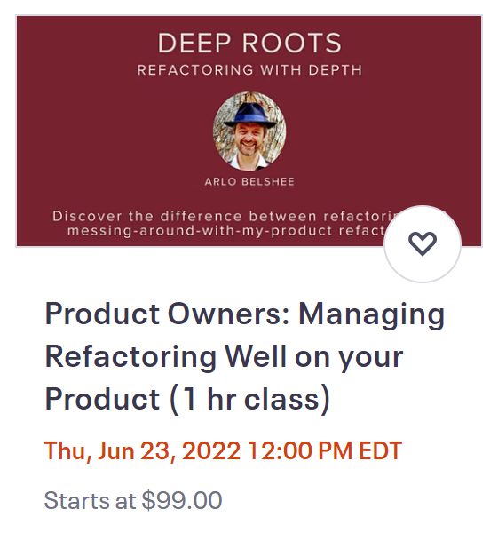
“craft” coupon code

Slide 33
